Slide 1
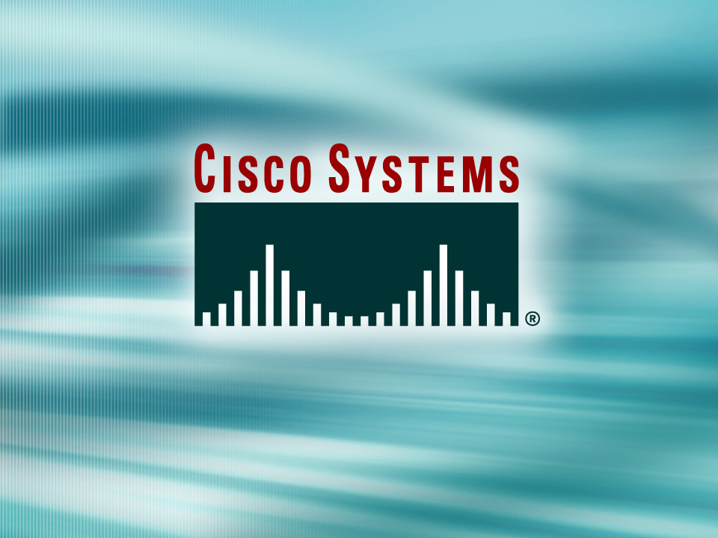
Presentation_ID
© 2001, Cisco Systems, Inc. All rights reserved.

Slide 2
Network Address Translation
Presenter:
“Insert your name Here”
“Insert your Email address here”

Slide 3
Agenda
Private Addressing
Network Address Translation (NAT)

Slide 4
Why use Private Addressing?

Slide 5
Solutions to IP address depletion.
Private IP Addresses:
  Class A --- 10.0.0.0 to 10.255.255.255 (= /8)
  Class B --- 172.16.0.0 to 172.31.255.255 (= /12)
  Class C --- 192.168.0.0 to 192.168.255.255 (= /16)
RFC 1631 - Network Address Translator (NAT)
Notes:
Because many private networks exist alongside public nets, grabbing "just any address" is strongly discouraged. RFC 1918 sets aside three blocks of IP addresses (i.e., a Class A, a Class B, and a Class C range) for private, internal use. Addresses in this range will not be routed on the Internet backbone . Internet routers immediately discard private addresses.
When using private addresses on a network that is connected to the Internet, you should filter packets and routing updates to avoid "leaking" any RFC 1918 addresses between autonomous systems. For example, if both you and your provider use addresses from the 192.168.0.0 /16 block, your routers could get confused if confronted with updates from both systems.
NAT is the process of swapping one address for another in the IP packet header. In practice, NAT is used to allow hosts that are privately addressed (using RFC 1918 addresses) to access the Internet.
When a host inside the private domain wants to transmit to a host on the outside world, it forwards the packet to the NAT-enabled device. The NAT process then looks inside the IP header and, if appropriate, replaces the inside IP address with a globally unique IP address. When an outside host sends a response, the NAT process receives it, checks the current table of network address translations, and replaces the destination address with the original inside source. NAT translations can occur dynamically or statically and can be used for a variety of purposes.
The most powerful feature of NAT routers is their capability to use port address translation (PAT), which allows multiple inside addresses to map to the same global address. This is sometimes called a "many-to-one" NAT. This procedure allows for many user inside of the private network to share one single external IP address. When using PAT the NAT router keeps track of the different conversations by mapping TCP and UDP port numbers.

Slide 6
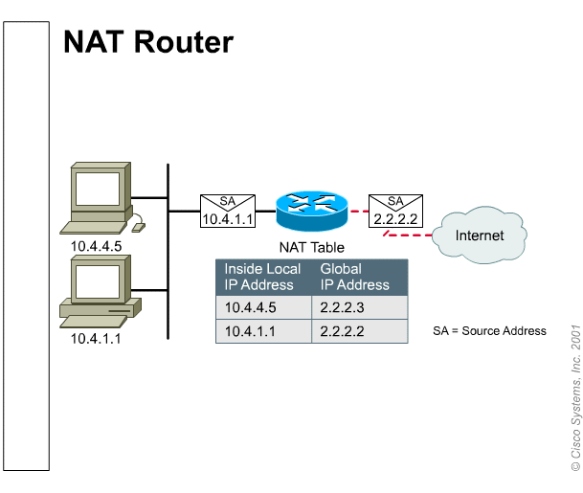
NAT a simple concept.

Slide 7
NAT Advantages
Conserves real (legal) addresses
Reduces Overlaps
Increases Flexibility when connecting to the Internet
Eliminates address renumbering (expansion of networks, merges)
Notes:
Conserves real (legal) addresses : By translating real (few) to Private addresses (many)
Reduces Overlaps : NAT can be used to resolve addressing issues that arise when inside addresses overlap with addresses in the outside network. This can occur when two companies merge, both with duplicate addresses in the networks.
Increases Flexibility when connecting to the Internet
Eliminates address renumbering (expansion of networks, merges)

Slide 8
NAT types.
Static NAT:
Fixed mapping of an internal address to an external address (Lookup Table)
Dynamic NAT:
Mapping is done dynamically on a first come first served basis
PAT (Overload):
Port address translation is used to allow many internal users to share a single ‘inside global’ address
TCP Load distribution:
Creates a ‘Virtual’ address for multiple internal addresses allowing for a “Round-Robin” access.

Slide 9



How does it work?
10.1.1.2
Port Translation Table
Static
Translation Table
10.1.1.2 = 203.10.10.2 10.1.1.3 = 203.10.10.3 10.1.1.4 = 203.10.10.4
Dynamic
Translation Table
10.1.1.4 = 203.10.10.2 10.1.1.2 = 203.10.10.3 10.1.1.3 = 203.10.10.4
Inside Local IP SRC Port DST Port Inside Global IP
10.1.1.4 1024 80 203.10.10.2
10.1.1.3
10.1.1.2 1122 80 203.10.10.2
10.1.1.3 1343 80 203.10.10.2
(config)# ip nat inside source static 10.1.1.2 203.10.10.2
(config)# ip nat pool NET-10 203.10.10.2 netmask 255.255.255.0
(config)# ip nat inside source list 2 pool NET-10 overload
(config)# ip nat pool NET-10 203.10.10.2 203.10.10.4 netmask 255.255.255.0
(config)# ip nat inside source list 2 pool NET-10
10.1.1.4

Slide 10
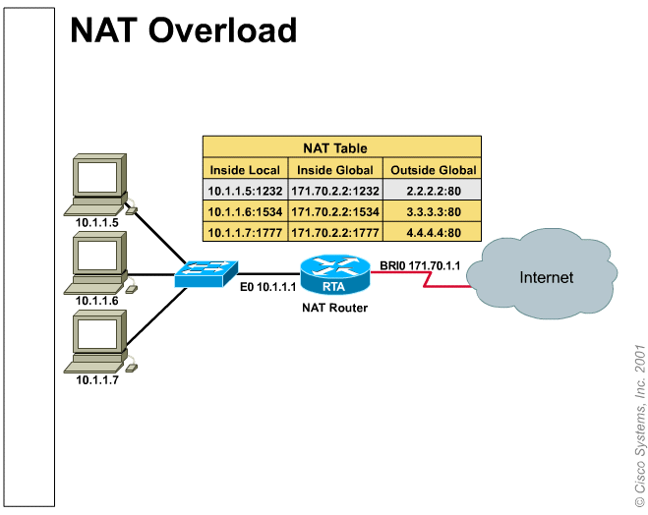
Most common situation for small Networks.
Notes:
Network 10.0.0.0 is the internal Private Addressing scheme
Network 171.70.2.2 is the real address assigned to this company
Network host:
2.2.2.2
3.3.3.3
4.4.4.4
Are real external addresses that the internal machines are trying to reach.
As we can see all the machines are using basically one real address

Slide 11
NAT issues.
BootP/ DHCP/SNMP –
  Requires storing the IP address in the BootP/DHCP/SNMP data field. NAT does not change these field.
DNS –
  Relies on a static IP address mapping to a host name. Use static translation.
Security –
  When using NAT there will be no encryption of the TCP header.
Difficult Debugging
Notes:
Bootp, dhcp & snmp use the payload of a packet to transfer IP information and therefore will not work in environments were NAT is used.
DNS (Domain Name Server) requires a fixed IP address for the translation of the “name” and if you are using NAT (other than static translation) the IP will not be fixed and therefore the DNS translation will be incorrect.
Certain TCP transmissions require (for security reasons) that the TCP header is encrypted. If a packet with the TCP header encrypted reaches the NAT engine the translation will destroy the encryption rendering the packet unusable.
Due to the fact that many point of the network may be translated it is very difficult to debug a system using NAT.

Slide 12
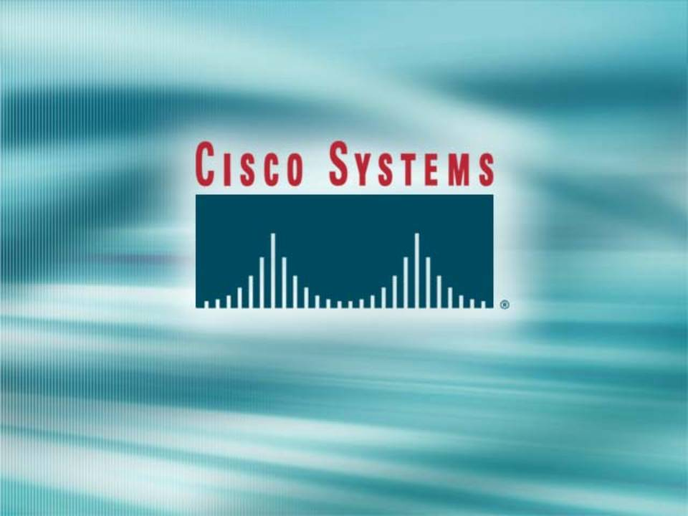

Slide 13
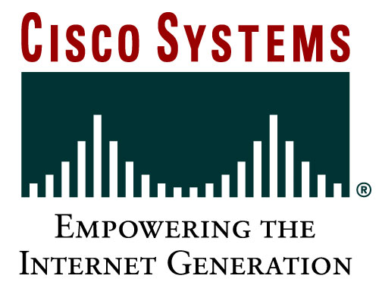
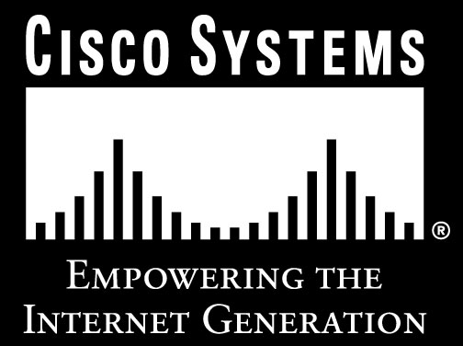
Presentation_ID
© 2001, Cisco Systems, Inc. All rights reserved.

